Slide 1
Networking and internetworking

Slide 2
89Networking and internetworking3.1 Introduction
3 Networking and internetworking
Distributed systems use local area networks, wide area networks and internetworks for communication
Changes in user requirements have resulted in the emergence of wireless networks and of high-performance networks with QoS guarantees
3.1 Introduction
transmission media
hardware devices
routers
switches
briges
hubs
repeaters
software components
protocol stacks
wire
communication handlers
cable
fibre
drivers
wireless channels

Slide 3
90Networking and internetworking3.1 Introduction
communication subsystem – hardware and software components that provide the communication facilities for a distributed system
hosts – computers and other devices that use the network for communication pur- poses
node – any computer or switching device attached to a network.
Internet constructed from any subnets
subnet – unit of routing (delivering data from one part of the Internet to another); collection of nodes that can all be reached on the same physical network
History
1961 – theoretical basis for packet switching (Leonhard Kleinock)
1962 – discussion on potential for interactive computing and wide area networking (J.C.R. Licklider and W. Clark)

Slide 4
91Networking and internetworking3.1 Introduction
1964 – outline of a practical design for reliable and effective wide area networks (Paul Baran)
Networking issues for distributed systems
Performance
Message transmission time = latency + length ⁄ data transfer rate
longer messages segmented – transmission time is the sum of transfering the segments
total system bandwidth of a network is a measure of throughput – the total vol- ume of traffic that can be transferred across the network in a given time
in most wide area networks messages can be transferred on several different channels simultaneously

Slide 5
Introduction
92Networking and internetworking3.1
The performance of networks deteriorates in conditions of overload
time required to access shared resources on a local network remains about a 1000x greater than that required to access resources that are resident in local memory
Scalability
Difficult to estimate the real size nowadays
The potential future size of the Internet
will be of order of the population of the planet
several billion nodes and hundreds of millions of active hosts

Slide 6
93Networking and internetworking3.1 Introduction
Reliability
Many applications are able to recover from communication failures and hence do not require guaranteed error-free communication
usually errors due to
software errors in sender or receiver
(for example, failure by the receiving computer to accept a packet)
buffer overfow
network errors (not that often though)
Security
firewall technology
chryptographic technology
virtual private network (VPN) techniques

Slide 7
Introduction
94Networking and internetworking3.1
Mobility
The Internet’s mechanisms have been adapted and extended to support mobil- ity, but the expected future growth in the use of mobile devices will demand further development
Quality of service
multimedia data transmission
Multicasting
simultaneous transmission of messages to several recipients

Slide 8
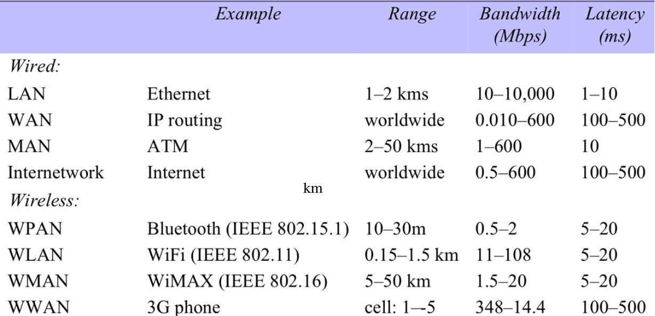
95Networking and internetworking3.2
Types of network
3.2 Types of network
types of networks are confusing because they seem to refer to the physical extent (local area, wide area), but they also identify physical transmission technologies and low-level protocols
Figure 3.1 Network performance

Slide 9
Types of network
96Networking and internetworking3.2
Personal area networks (PANs)
Local area networks (LANs)
segment – section of cable that serves a department or a floor of a building and may have many computers attached.
No routing of messages is required within a segment, since the medium provides direct connections between all of the computers connected to it
The total system bandwidth is shared between the computers con- nected to a segment
–Ethernet emerged as the dominant technology for wired local area net- works. It was originally produced in the early 1970s with a bandwidth of 10 Mbps (million bits per second) and extended to 100 Mbps, 1000 Mbps (1 gigabit per second) and 10 Gbps versions more recently

Slide 10
97Networking and internetworking3.2 Types of network
Ethernet
lacks the latency and bandwidth guarantees needed by many multime- dia applications
high-speed Ethernets have been deployed in a switched mode that overcomes these drawbacks to a significant degree, though not as ef- fectively as ATM
Wide area networks (WANs)
communication medium linking a set of dedicated computers – routers
latencies can be as high as 0.1 ... 0.5 seconds
Example: Europe-Australia
via terrestial link 0.13 seconds
satellite 0.20 seconds

Slide 11
Types of network
98Networking and internetworking3.2
Metropolitan area networks (MANs)
based on the high-bandwidth copper and fibre optic cabling
distances upto 50 km
technology ranging from Ethernet to ATM (Asynchronous Transfer Mode)
Wireless local area networks (WLANs)
IEEE 802.11 standard (WiFi)
Wireless metropolitan area networks (WMANs)
IEEE 802.16 WiMAX standard

Slide 12
Types of network
99Networking and internetworking3.2
Wireless wide area networks (WWANs)
GSM (3G, 4G); UMTS (Universal Mobile Telecommunication System)
rates upto 100 Mbps
Internetworks
several networks linked together
routers, gateways

Slide 13
Network principles
Network principles
Basis – packet switching technique (developed in 1960s)
packets addressed to different destinations to share a single communications link
Packets are queued in a buffer and transmitted when the link is available
Communication is asynchronous – messages arrive with a delay depending upon properties and utilization of the network
Packet transmission
messages – sequences of data items of arbitrary length
– subdivided into packets
* packets have a restricted length

Slide 14
Network principles
101Networking and internetworking3.3
Data streaming
streaming – transmission and display of audio and video in real time
video stream requires
1.5 Mbps if data compressed
120 Mbps inf uncompresses
channel from source to destination of a multimedia stream
predefined route
reserved set of resources
buffering where appropriate for smoothness
ATM
IPv6 includes features for real-time separate IP stream treatment

Slide 15
Network principles
102Networking and internetworking3.3
Switching schemes
Broadcast
involves no switching
some LAN technologies (including Ethernet) based on broadcasting
wireless networking with nodes grouped in cells
Circuit switching
plain old telephone system (or POTS) – typical switching network
Packet switching
store-and-forward network

Slide 16
Network principles
103Networking and internetworking3.3
Frame relay
switching small packets called frames on the fly
switching nodes route frames based on the examination of their first few bits
frames as a whole are not stored at nodes but pass through them as short streams of bits

Slide 17
Network principles
104Networking and internetworking3.3
Protocols
protocol – well-known set of rules and formats to be used for communication between processes in order to perform a given task
two important parts to it:
a specification of the sequence of messages that must be exchanged
a specification of the format of the data in the messages
The existence of well-known protocols enables the separate software components of distributed systems to be developed independently and implemented in different programming languages on computers that may have different order codes and data representations
protocol is implemented by a pair of software modules located in the sending and receiving computers.

Slide 18
2-2 THE OSI MODEL
Established in 1947, the International Standards Organization (ISO) is a multinational body dedicated to worldwide agreement on international standards. An ISO standard that covers all aspects of network communications is the Open Systems Interconnection (OSI) model. It was first introduced in the late 1970s.
Topics discussed in this section:
Layered Architecture Peer-to-Peer Processes
Encapsulation
2.<number>
Notes:
<number>

Slide 19

Note
ISO is the organization. OSI is the model.
2.<number>
Notes:
<number>

Slide 20
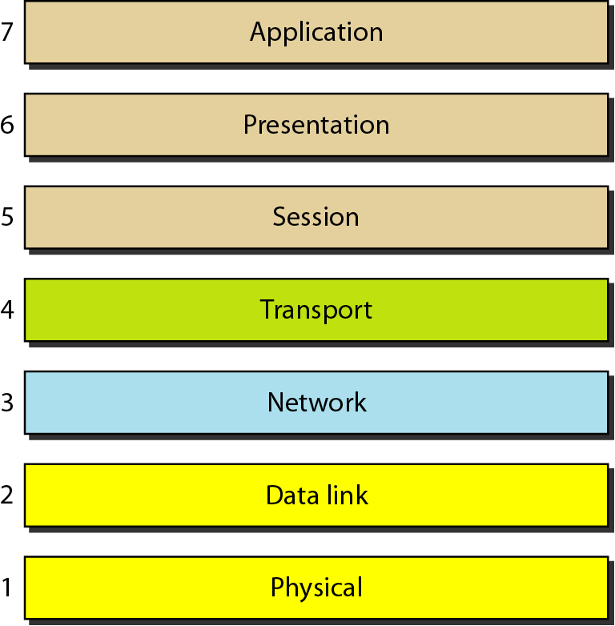
Figure 2.2 Seven layers of the OSI model
2.<number>
Notes:
<number>

Slide 21
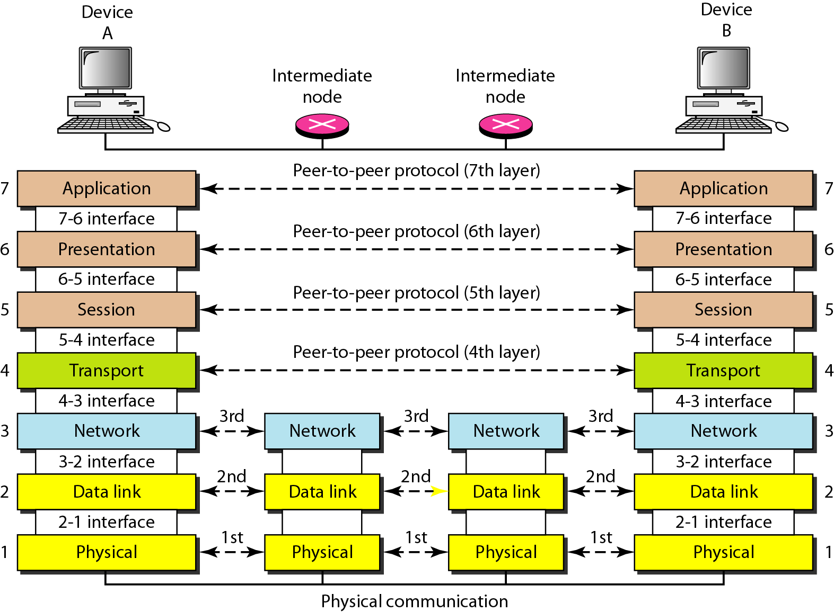
Figure 2.3 The interaction between layers in the OSI model
2.<number>
Notes:
<number>

Slide 22
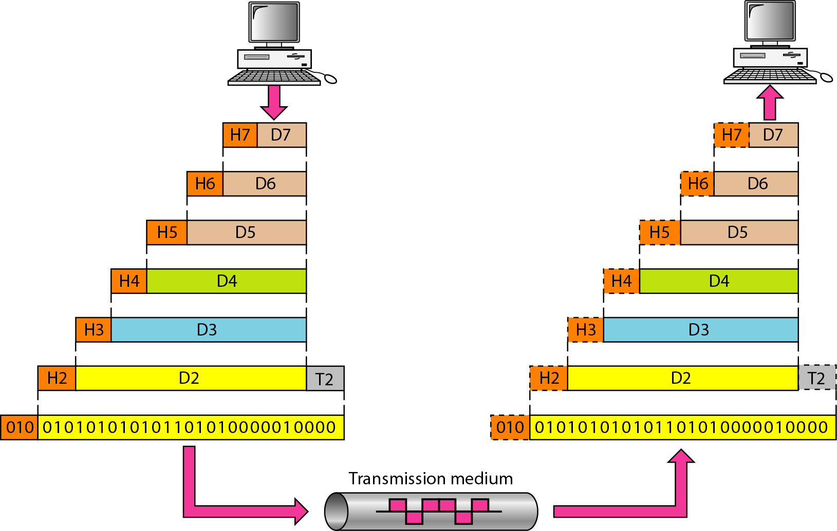
Figure 2.4 An exchange using the OSI model
2.<number>
Notes:
<number>

Slide 23
2-3 LAYERS IN THE OSI MODEL
In this section we briefly describe the functions of each layer in the OSI model.
Topics discussed in this section:
Physical Layer Data Link Layer
Network Layer
Transport Layer
Session Layer
Presentation Layer
Application Layer
2.<number>
Notes:
<number>

Slide 24
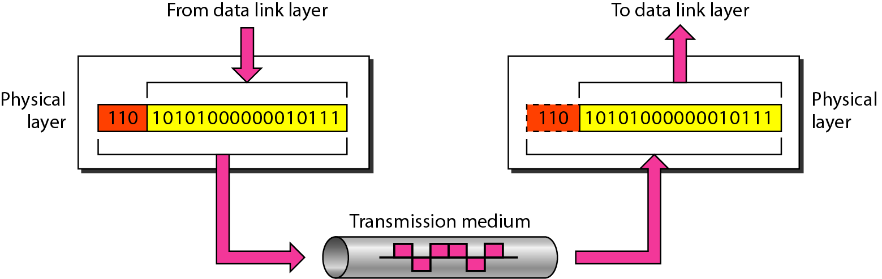
Figure 2.5 Physical layer
2.<number>
Notes:
<number>

Slide 25
Note
The physical layer is responsible for movements of
individual bits from one hop (node) to the next.
2.<number>
Notes:
<number>

Slide 26
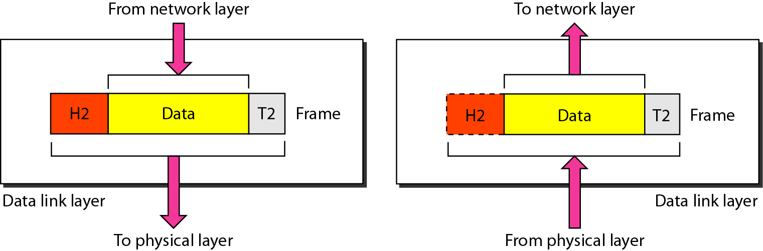
Figure 2.6 Data link layer
2.<number>
Notes:
<number>

Slide 27
Note
The data link layer is responsible for moving frames from one hop (node) to the next.
2.<number>
Notes:
<number>

Slide 28
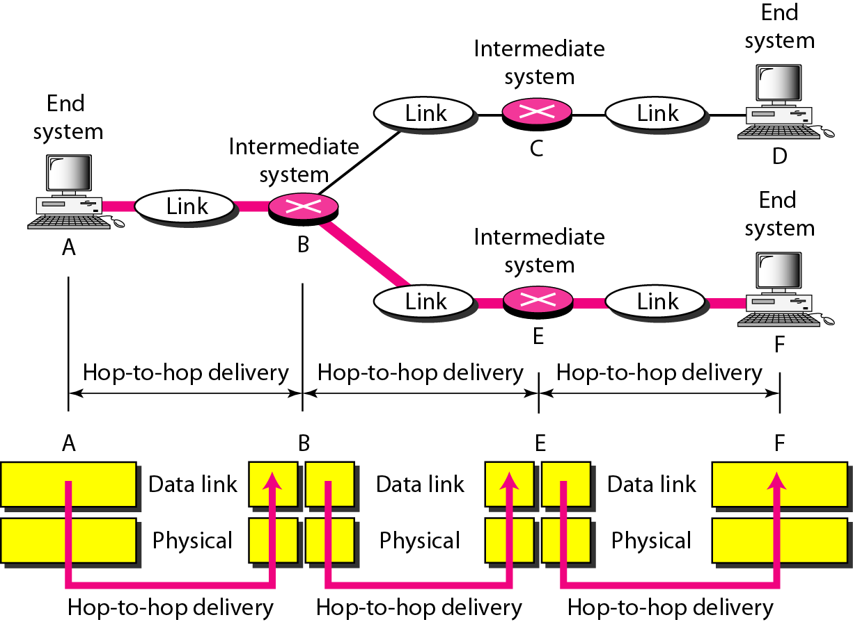
Figure 2.7 Hop-to-hop delivery
2.<number>
Notes:
<number>

Slide 29
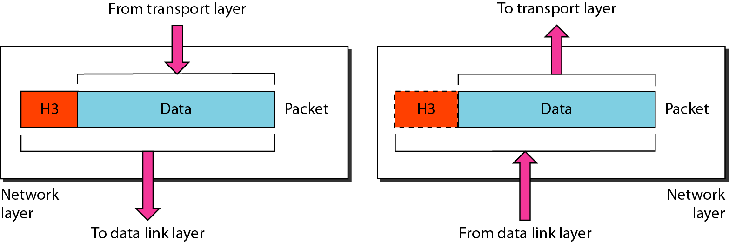
Figure 2.8 Network layer
2.<number>
Notes:
<number>

Slide 30
Note
The network layer is responsible for the delivery of individual packets from
the source host to the destination host.
2.<number>
Notes:
<number>

Slide 31
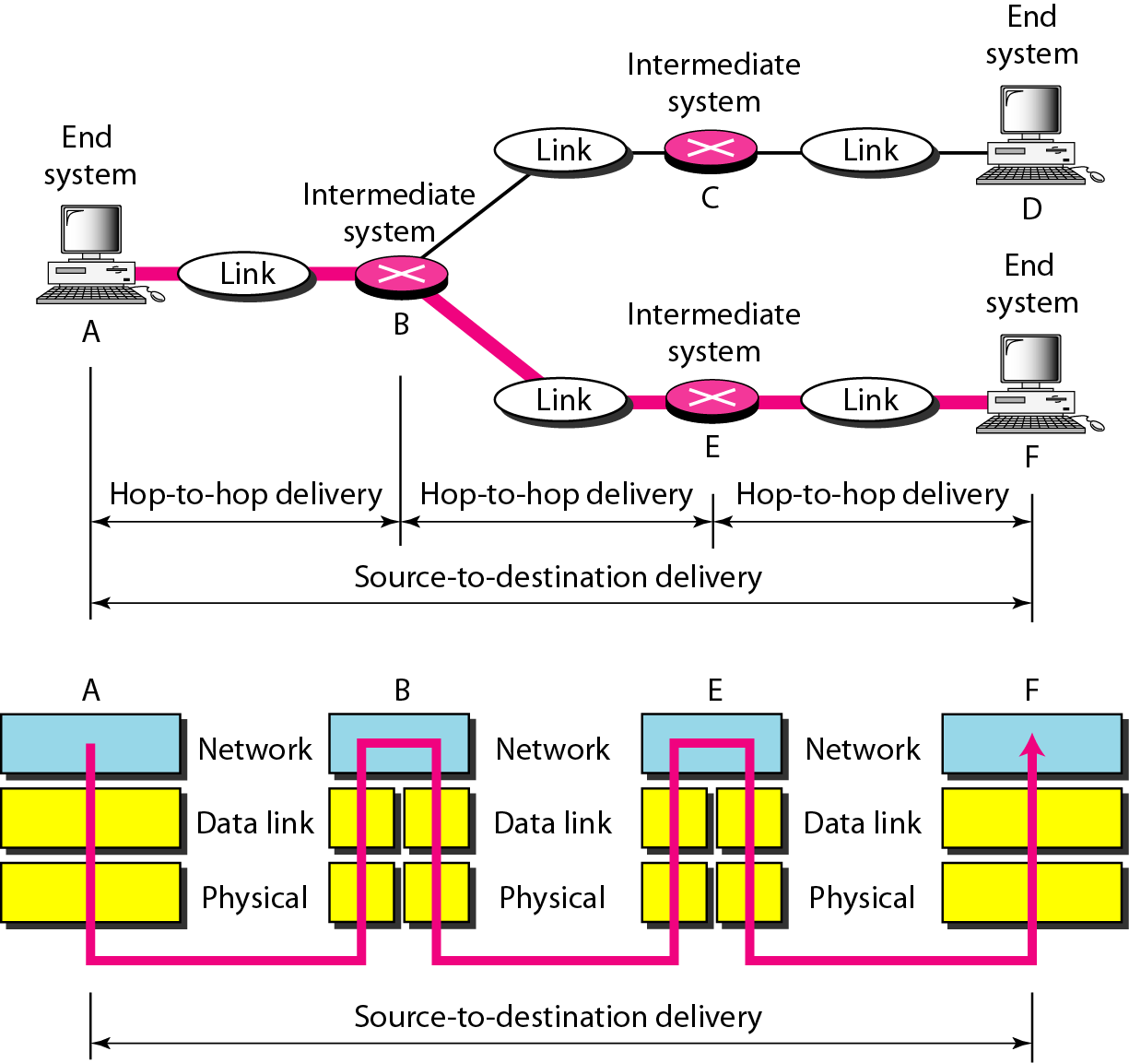
Figure 2.9 Source-to-destination delivery
2.<number>
Notes:
<number>

Slide 32
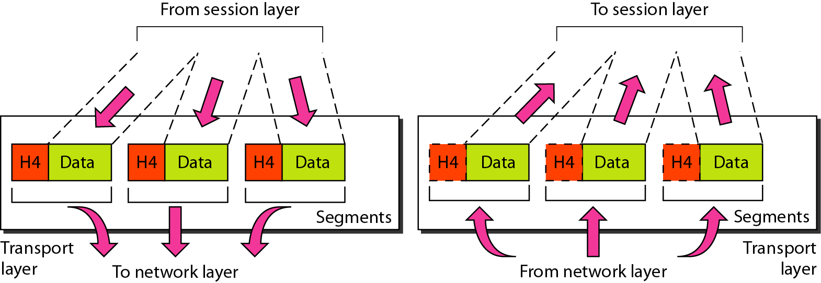
Figure 2.10 Transport layer
2.<number>
Notes:
<number>

Slide 33
Note
The transport layer is responsible for the delivery of a message from one process to another.
2.<number>
Notes:
<number>

Slide 34
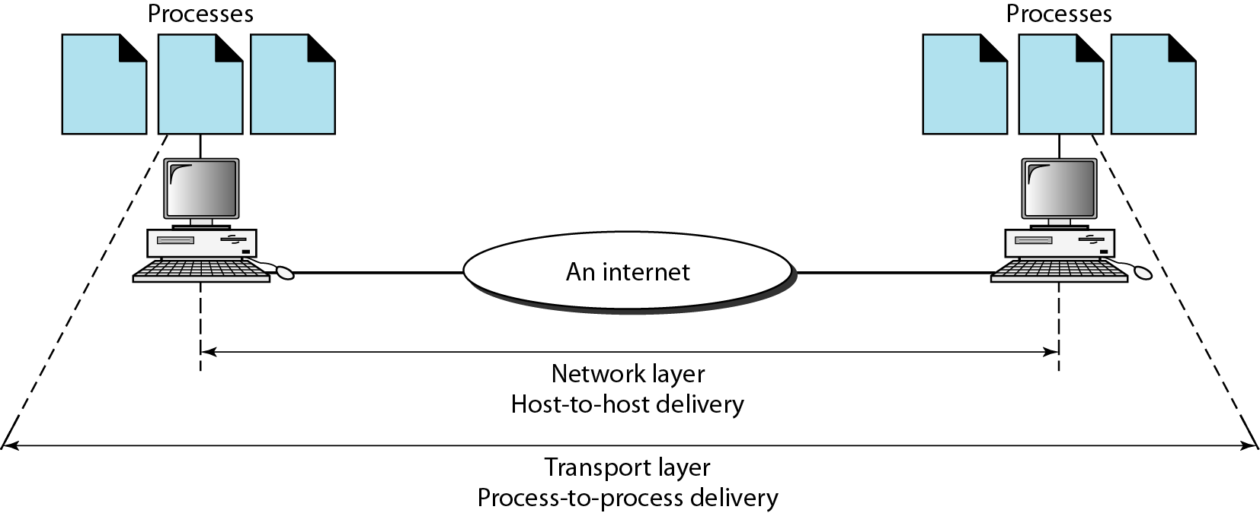
Figure 2.11 Reliable process-to-process delivery of a message
2.<number>
Notes:
<number>

Slide 35
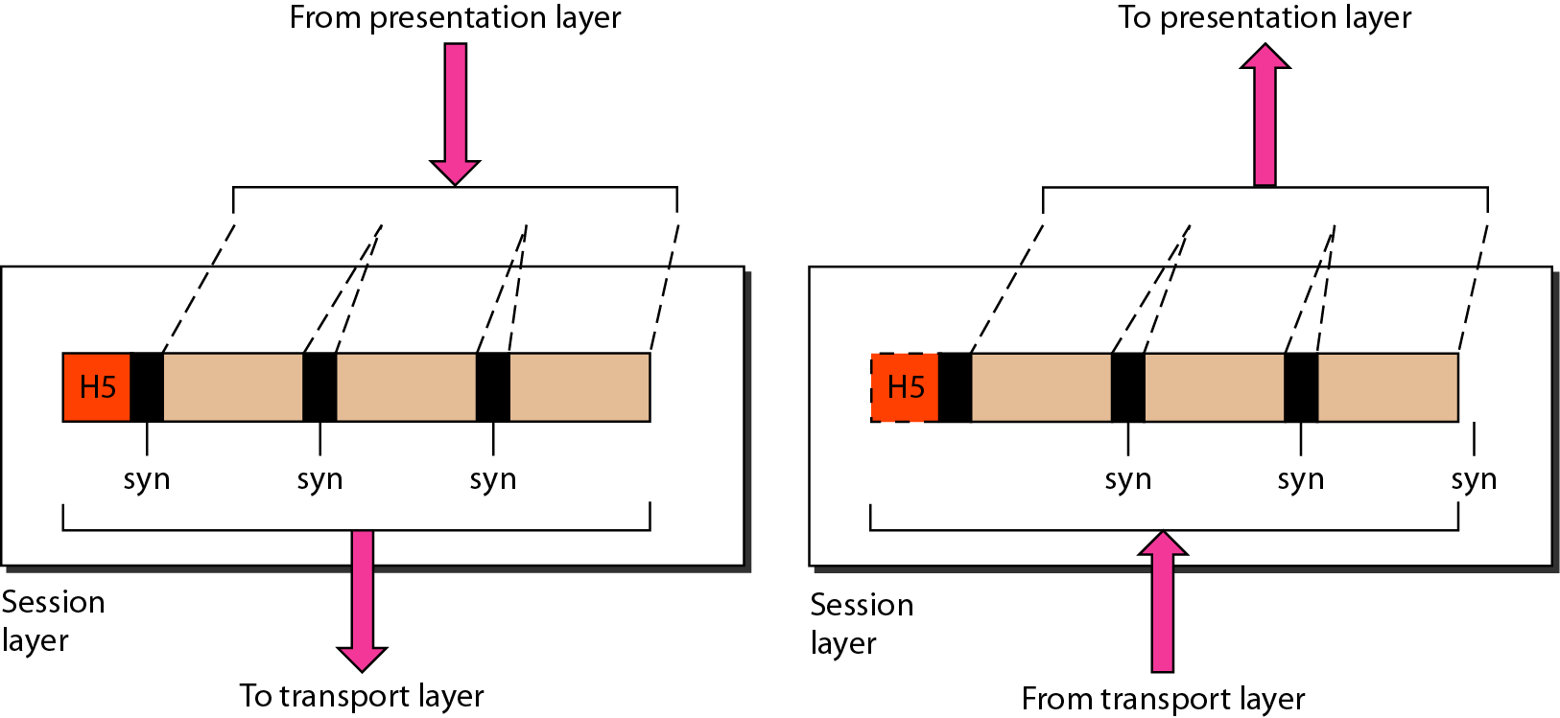
Figure 2.12 Session layer
2.<number>
Notes:
<number>

Slide 36
Note
The session layer is responsible for dialog control and synchronization.
2.<number>
Notes:
<number>

Slide 37
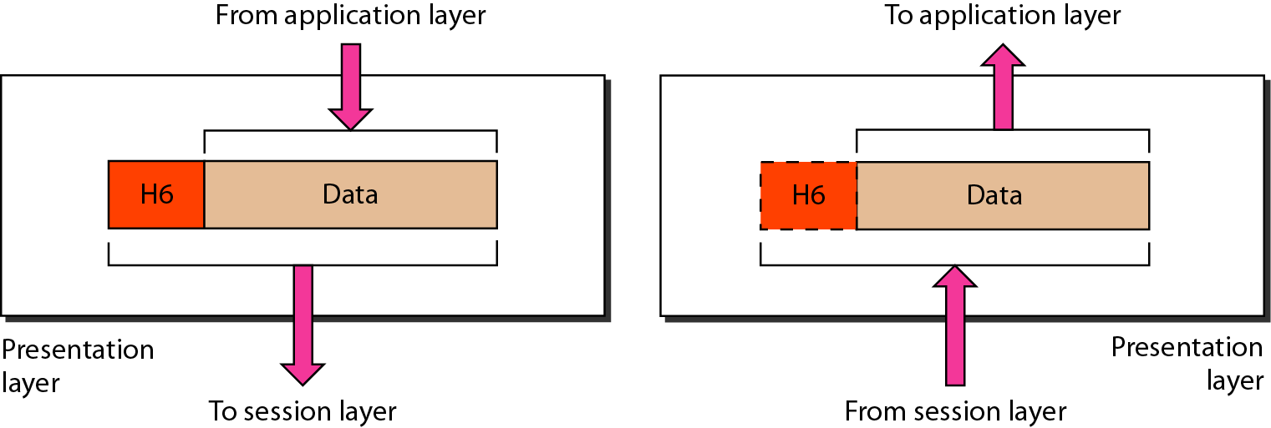
Figure 2.13 Presentation layer
2.<number>
Notes:
<number>

Slide 38
Note
The presentation layer is responsible for translation, compression, and encryption.
2.<number>
Notes:
<number>

Slide 39
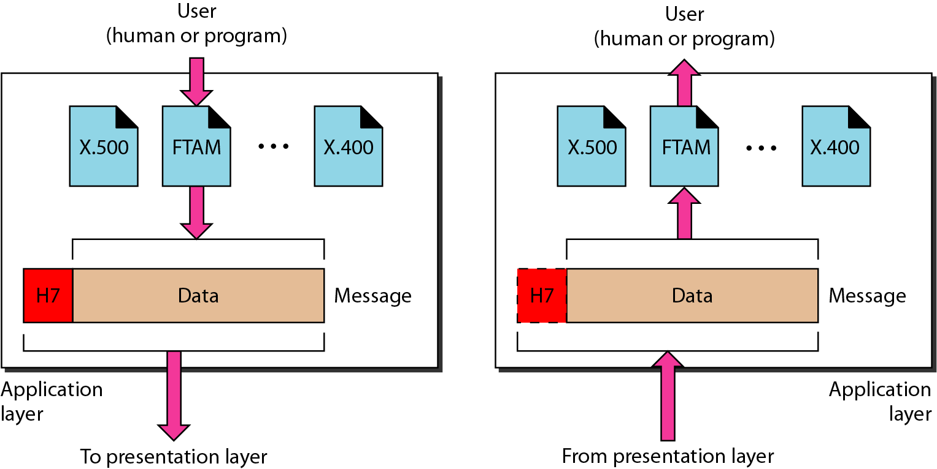
Figure 2.14 Application layer
2.<number>
Notes:
<number>

Slide 40
Note
The application layer is responsible for providing services to the user.
2.<number>
Notes:
<number>

Slide 41
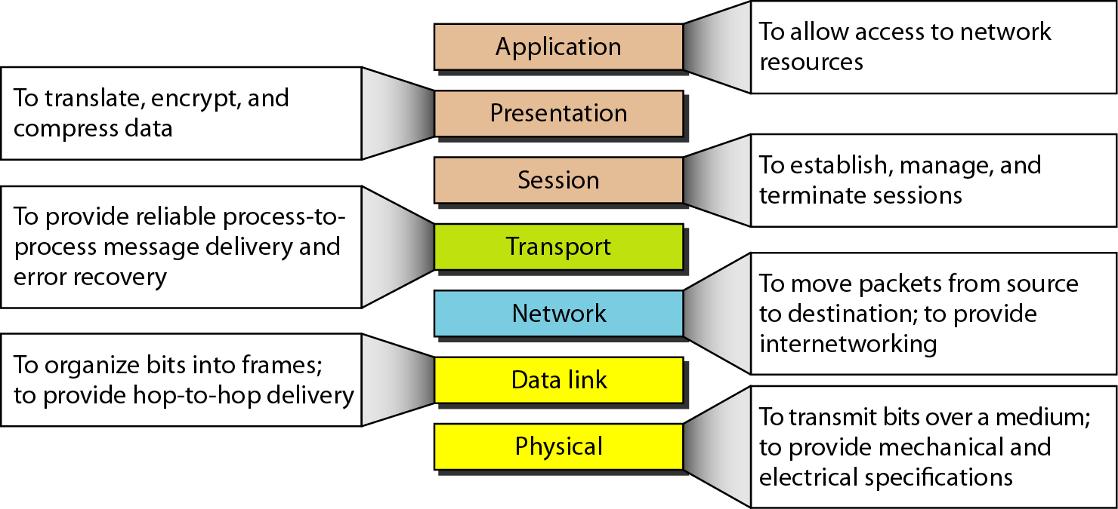
Figure 2.15 Summary of layers
2.<number>
Notes:
<number>

Slide 42
2-4 TCP/IP PROTOCOL SUITE
The layers in the TCP/IP protocol suite do not exactly match those in the OSI model. The original TCP/IP protocol suite was defined as having four layers: host-to-network, internet, transport, and application. However, when TCP/IP is compared to OSI, we can say that the TCP/IP protocol suite is made of five layers: physical, data link, network, transport, and application.
Topics discussed in this section:
Physical and Data Link Layers Network Layer Transport Layer
Application Layer
2.<number>
Notes:
<number>

Slide 43
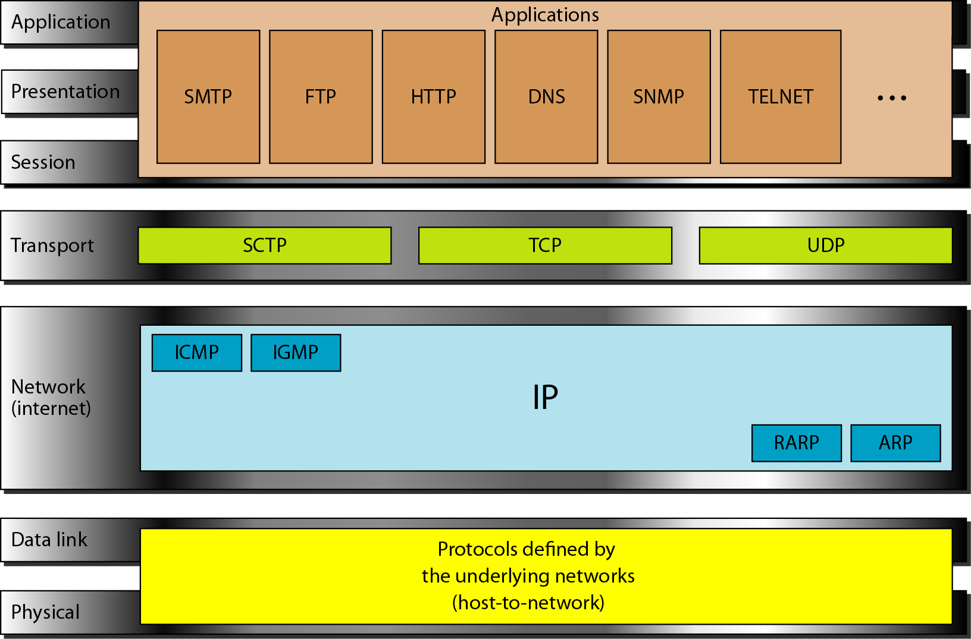
Figure 2.16 TCP/IP and OSI model
2.<number>
Notes:
<number>

Slide 44
2-5 ADDRESSING
Four levels of addresses are used in an internet employing the TCP/IP protocols: physical, logical, port, and specific.
Topics discussed in this section:
Physical Addresses Logical Addresses Port Addresses Specific Addresses
2.<number>
Notes:
<number>

Slide 45
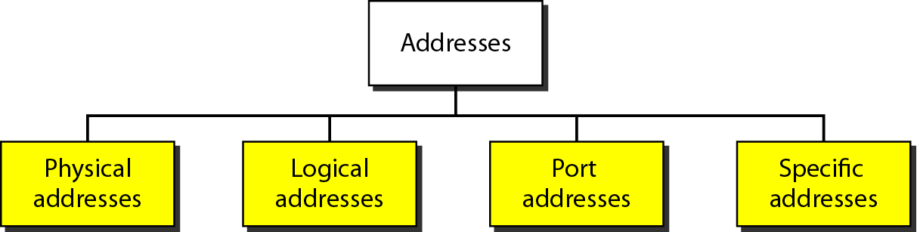
Figure 2.17 Addresses in TCP/IP
2.<number>
Notes:
<number>

Slide 46
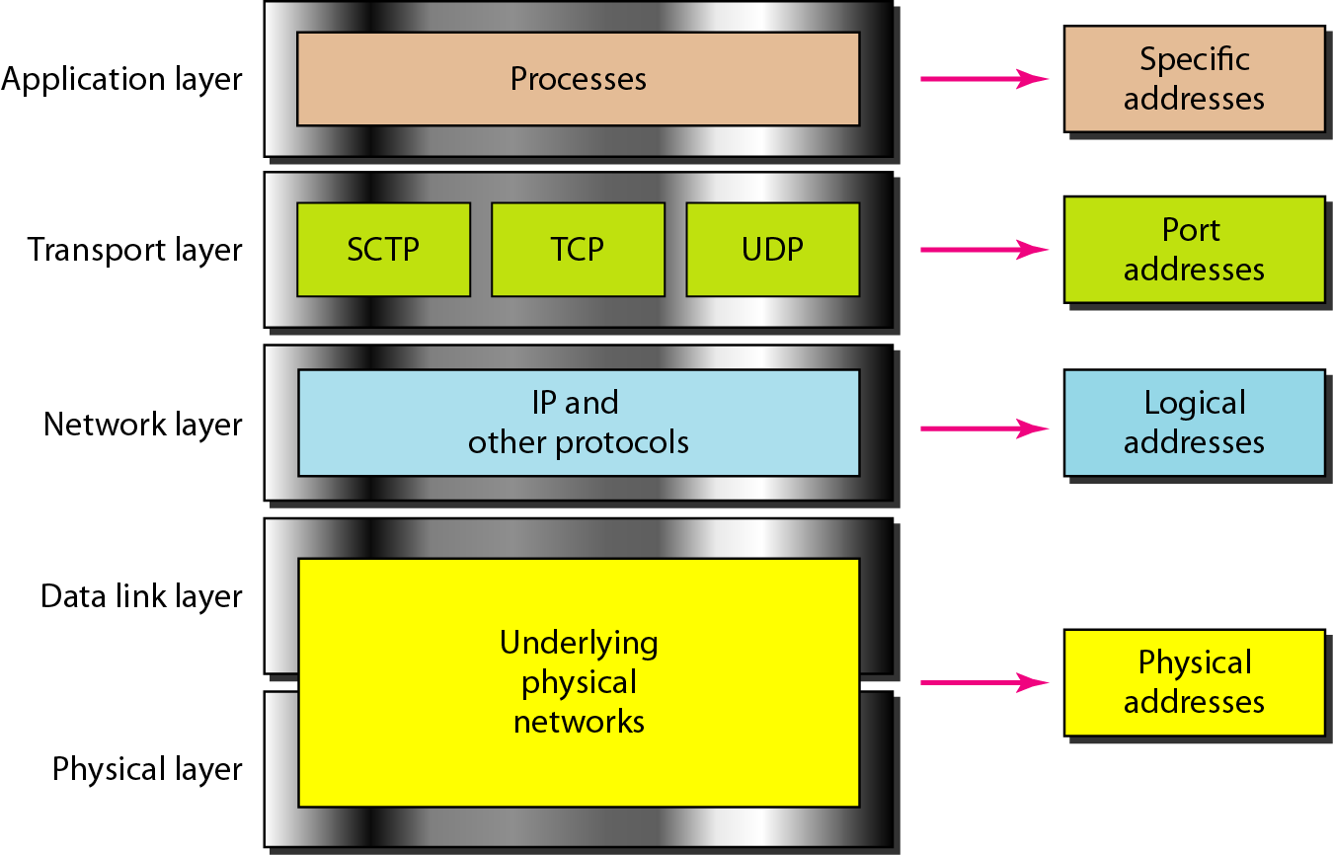
Figure 2.18 Relationship of layers and addresses in TCP/IP
2.<number>
Notes:
<number>

Slide 47
Network principles
111Networking and internetworking3.3
Packet delivery
Datagram packet delivery
‘ datagram’ refers to the similarity of this delivery mode to the way in which letters and telegrams are delivered
Virtual circuit packet delivery:
analogous to a telephone network
A virtual circuit must be set up before packets can pass from a source host A to destination host B
Virtual circuit currently in use: ATM ( Asynchronous Transfer Mode)

Slide 48
Virtual Circuits | Datagram Networks
Virtual Circuits | Datagram Networks
Virtual circuits are connection-oriented, which means that there is a reservation of resources like buffers, bandwidth, etc. for the time during which the newly setup VC is going to be used by a data transfer session. | It is connectionless service. There is no need for reservation of resources as there is no dedicated path for a connection session.
A virtual circuit network uses a fixed path for a particular session, after which it breaks the connection and another path has to be set up for the next session. | A Datagram based network is a true packet switched network. There is no fixed path for transmitting data.
All the packets follow the same path and hence a global header is required only for the first packet of connection and other packets will not require it. | Every packet is free to choose any path, and hence all the packets must be associated with a header containing information about the source and the upper layer data.

Slide 49
Virtual Circuits Datagram Circuits
Packets reach in order to the destination as data follows the same path. | Data packets reach the destination in random order, which means they need not reach in the order in which they were sent out.
Virtual Circuits are highly reliable. | Datagram networks are not as reliable as Virtual Circuits.
Implementation of virtual circuits is costly as each time a new connection has to be set up with reservation of resources and extra information handling at routers. | But it is always easy and cost-efficient to implement datagram networks as there is no need of reserving resources and making a dedicated path each time an application has to communicate.

Slide 50
Network principles
112Networking and internetworking3.3
Routing
in large networks – adaptive routing – the best route for communication between two points in the network is re-evaluated periodically
Two parts of routing algorithm:
make decisions that determine the route taken by each packet 2.dynamically update the knowledge of the network

Slide 51
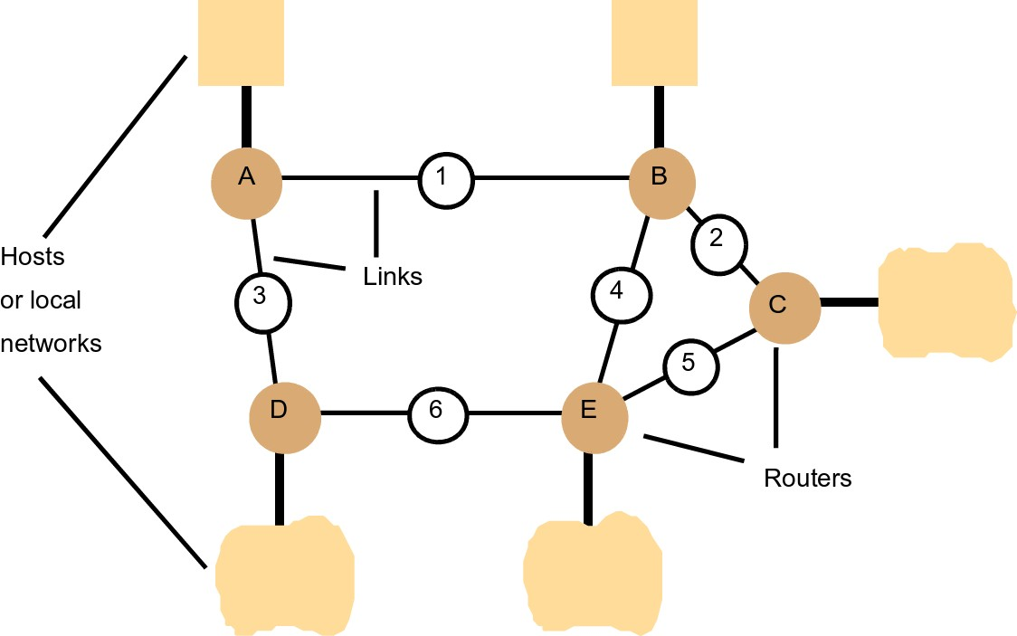
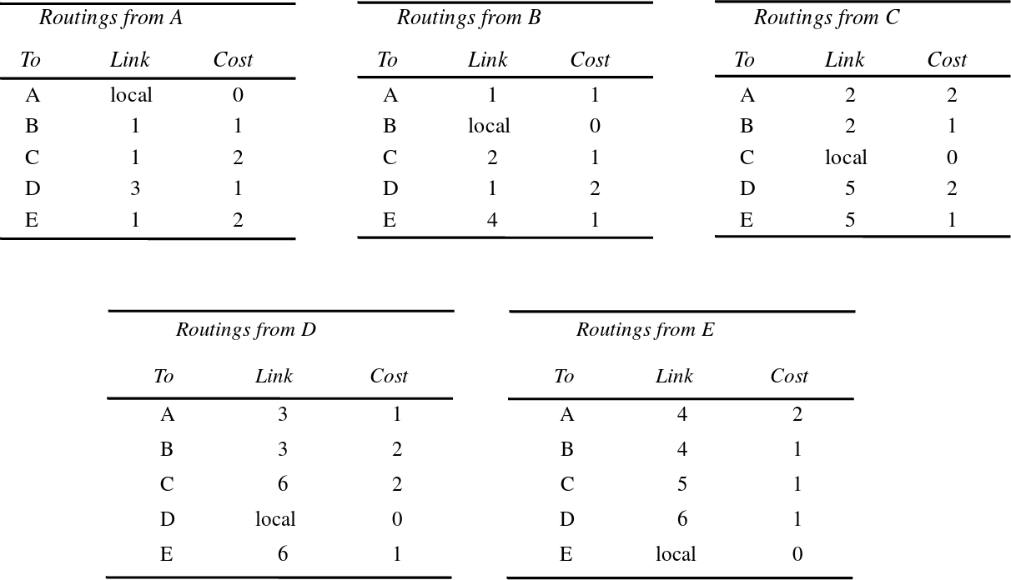
113Networking and internetworking3.3 Network principles
Figure 3.8 Routing tables for the network in Figure 3.7
Figure 3.7 Routing in a wide area
network

Slide 52
114Networking and internetworking3.3 Network principles
A simple routing algorithm
’distance vector’ algorithm, instance of Bellman’s shortest path algorithm (Bell- man 1957)
Router information protocol (RIP)
Periodically, and whenever the local routing table changes, send the table (in a summary form) to all accessible neighbours ( – send an RIP packet containing a copy of the table on each non-faulty outgoing link)
When a table is received from a neighbouring router
if the received table shows a route to a new destination, or
a better (lower-cost) route to an existingdestination
—- update the local table with the new route
If the table was received on link n and it gives a different cost than the local table for a route that begins with link n:
replace the cost in the local table with the new cost.

Slide 53
We can now describe the datagram forwarding algorithm in the following way:
D = destination IP address
for each forwarding table entry SubnetNumber, SubnetMask, NextHop
D1 = SubnetMask & D
if D1 = SubnetNumber
if NextHop is an interface
deliver datagram directly to destination
else
deliver datagram to NextHop (a router)
<number>

Slide 54
IP Routing Table
Typically a routing table contains pair (N, R) where N is the net ID of the destination network and R is the IP address of the next router along the path to network N.
Fig below will help to explain routing tables. Let us concentrate on router R which is directly connected to network 20.0.0.0 and 30.0.0.0 (class A net_ID) can use direct delivery to send to host on either of these networks.
A datagram destined for a host on network 40.0.0.0, R routes it to address of router S, 30.0.0.7. R can reach on 30.0.0.7 directly and S can reach on network 40.0.0.0 directly.
Network
Network
20.0.0.0
Q
10.0.0.0
20.0.0.5
10.0.0.5
20.0.0.6
R
Network
30.0.0.6
30.0.0.0
40.0.0.0
S
30.0.0.7
Network
<number>
40.0.0.7

Slide 55
Example-4 Show the routing table of router R
20.0.0.0
Q
10.0.0.0
20.0.0.5
10.0.0.5
20.0.0.6
R
30.0.0.6
30.0.0.0
40.0.0.0
S
30.0.0.7
40.0.0.7
Routing table of R
To Reach Hosts on Network | Route to this address
20.0.0.0 | Deliver Directly
30.0.0.0 | Deliver Directly
10.0.0.0 | 20.0.0.5
40.0.0.0 | 30.0.0.7
<number>

Slide 56


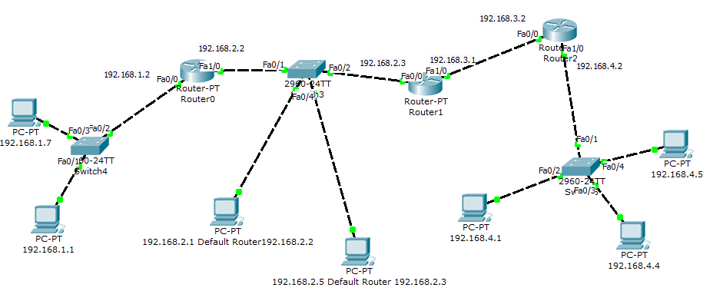

<number>

Slide 57
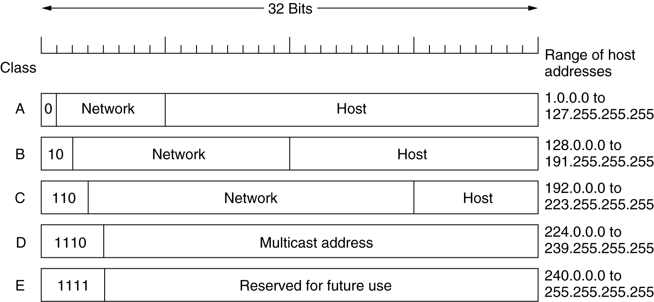
IP Addresses
IP address formats.
<number>

Slide 58
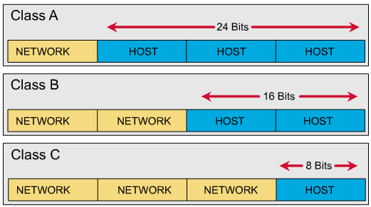
Class A (24 bits for hosts) 2²⁴ - 2* = 16,777,214 maximum hosts
Class B (16 bits for hosts) 2¹⁶ - 2* = 65,534 maximum hosts
Class C (8 bits for hosts) 2⁸ - 2* = 254 maximum hosts
Subtracting the network and broadcast reserved address
Within a given network, two host addresses are reserved for special purpose. The "0" address is assigned a network address and "255" is assigned to a broadcast address, and they cannot be assigned to a host.
<number>

Slide 59
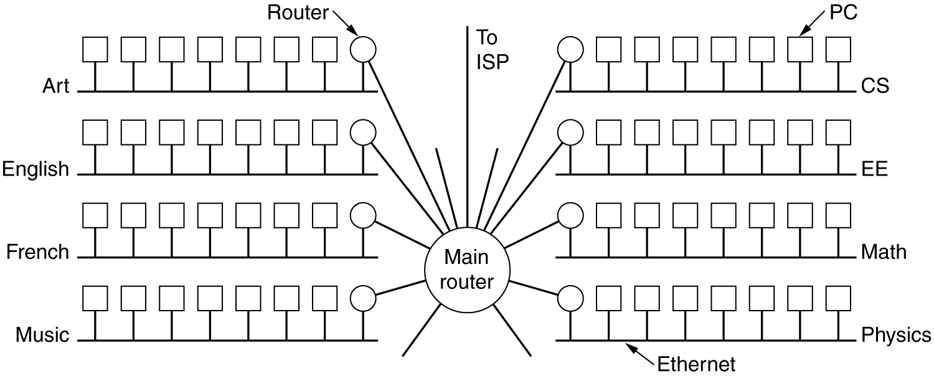
Subnets
A big network usually spitted into several small parts for internal use but still act like a single network to the outside world.
A typical campus network might look like fig below, with a main router connected to an ISP or regional network and numerous Ethernets spread around campus in different departments. Each of the Ethernets has its own router connected to the main router (via backbone LAN). In the internet literature, the part of the network (in this case, Ethermets) are called subnets.
A campus network consisting of LANs for various departments.
<number>

Slide 60
Subnets (2)
An IP address has two components, the network address and the host address. A subnet mask separates the IP address into the network and host addresses (<network> <host>). Subnetting further divides the host part of an IP address into a subnet and host address (<network> <subnet> <host>).
<number>

Slide 61
A Subnet mask is a 32-bit number that masks an IP address, and divides the IP address into network address and host address. Subnet Mask is made by setting network bits to all "1"s and setting host bits to all "0"s.
It is called a subnet mask because it is used to identify network address of an IP address by performing bitwise AND operation on the subnet mask.
<number>

Slide 62
The default subnet mask used for class A, B, C and D are:
Class A: 11111111.00000000. 00000000. 00000000
255.0.0.0
Class B: 11111111. 11111111. 00000000. 00000000
255.255.0.0
Class C: 11111111. 11111111. 11111111. 00000000
255.255.255.0
For example we have a class C IP address of a host: 192.168.23.4
Anding the IP address with default subnet mask 255.255.255.0 give the result of 192.168.23.0 which is the net ID part of the IP address.
<number>

Slide 63
The possible hosts will be:
192.168.23.1
192.168.23.2
192.168.23.3
192.168.23.4
…………….
192.168.23.254
192.168.23.0 and 192.168.23.255 are excluded as mentioned before. Therefore the number of hosts is 2⁸-2 = 254
<number>

Slide 64
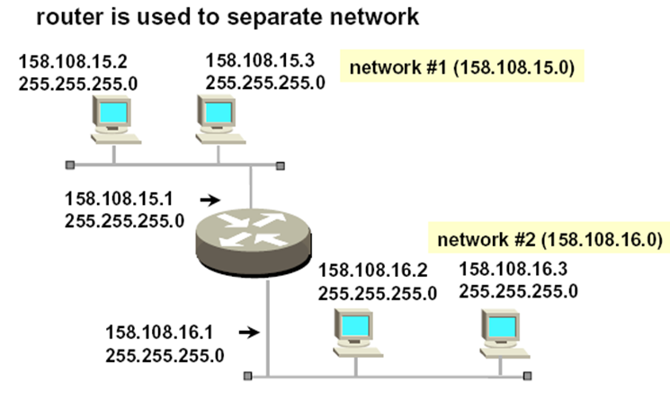
Example-1
192
192
192.
192
192.
192.
192.
192
<number>

Slide 65
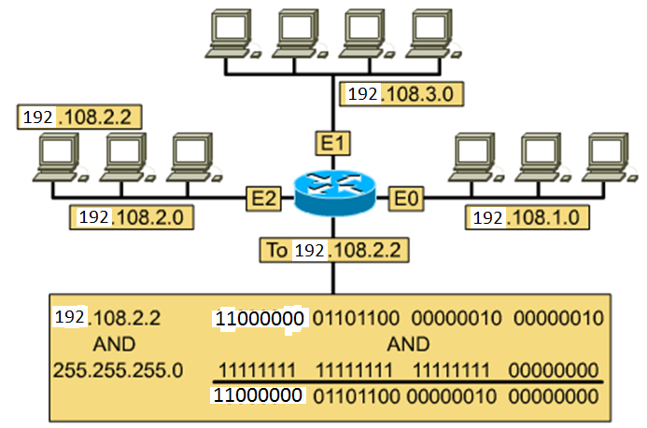
Performing the AND Function
Example-2: A host wants to send packet to a host 192.108.2.2. First the sender has to find the net ID of the receiver.
in decimal 192.108.2.0
<number>

Slide 66
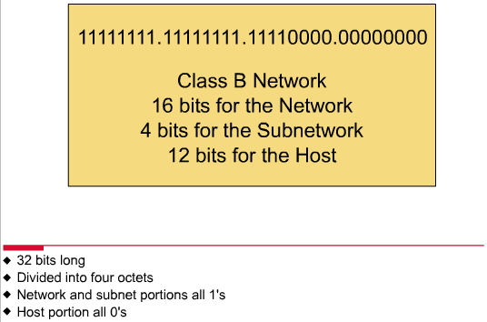
Subnet Mask
Follow these steps to determine the subnet mask:
Replace the network and subnet portion of the address with all 1s.
Replace the host portion of the address with all 0s.
Convert the binary expression back to dotted-decimal notation.
<number>

Slide 67
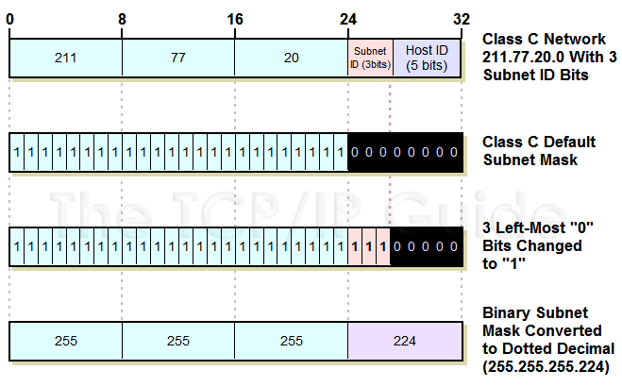
Default Subnet mask
255.255.255.0
Costumed Subnet mask

Slide 68
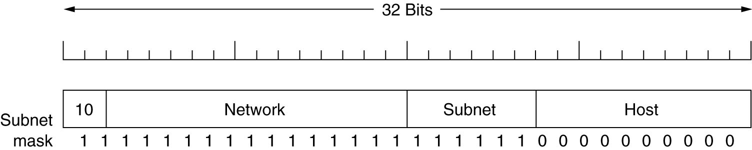
The example of a customed subnet mask for class B is like:
A class B network subnetted into 64 subnets.
Example: Determine the number of subnet and host per subnet
Ans. The number of subnet = 2⁶ = 64
The number of hosts/subnet = 2¹⁰-2= 1022
<number>

Slide 69
Classless Interdomain Routing (CIDR)
or Supernetting
Classless interdomain routing (CIDR, pronounced “cider”) is a technique that addresses two scaling concerns in the Internet:
the growth of backbone routing tables as more and more network numbers need to be stored in them
ii) the potential for the 32-bit IP address space to be exhausted well before the 4 billionth host is attached to the Internet.
<number>

Slide 70
Supernetting, also called Classless Inter-Domain Routing (CIDR), is a way to aggregate multiple Internet addresses of the same class. Supernetting is the idea of combining two or more blocks of IP addresses that together compose a continuous range of addresses (no missing addresses in the middle). You create a supernet when you have a need to place more hosts on a single network than currently will work in a classful configuration.
The original Internet Protocol (IP) defines IP addresses in four major classes of address structure, Classes A through D. Each class allocates one portion of the 32-bit Internet address format to a netwok address and the remaining portion to the specific host machines within the network.
<number>

Slide 71
Using supernetting, the network address 192.168.2.0/24 and an adjacent address 192.168.3.0/24 can be merged into 192.168.2.0/23. The "23" at the end of the address says that the first 23 bits are the network part of the address, leaving the remaining nine bits for specific host addresses.
Supernetting is most often used to combine Class C network addresses and is the basis for most routing protocols currently used on the Internet.
The Border Gateway Protocol (BGP), the prevailing exterior (interdomain) gateway protocol and the Open Shortest Path First (OSPF) router protocol both support supernetting, but the older exterior or interdomain protocols, the Exterior Gateway Protocol (EGP) and the Routing Information Protocol (RIP) do not support it.
<number>

Slide 72
For any class C IP address 192.168.1.0 and default subnet mask 255.255.255.0 we have 2⁸-2 = 254 hosts. Let us now see how class C address an produce more than 254 hosts.
The basic principle is to take one or more bits from the net ID part as the host ID part. For example if we use subnet mask of 23 bits instead of 24 bits of default subnet mask then we get 9 bits for host ID the the number of hosts will be 2⁹-2.
In this case net ID does not fall in any category hence called classless IP. Such mask is called CIDR mask.
<number>

Slide 73
HUB, Bridge Switch and Router
Hub A hub is the simplest of these devices. Any data packet coming from one port is sent to all other ports. It is then up to the receiving computer to decide if the packet is for it or not. The biggest problem with hubs is their simplicity. Since every packet is sent out to every computer on the network, there is a lot of wasted transmission. This means that the network can easily become bogged down. Hubs are typically used on small networks where the amount of data going across the network is never very high.
<number>

Slide 74
There are mainly two types of hubs:
1. Passive: The signal is forwarded as it is (so it doesn’t need power supply).
2. Active: The signal is amplified, so they work as repeaters. In fact they have been called multiport repeaters (use power supply). Hubs can be connected to other hubs using an uplink port to extend the network.
OSI Model: Active Hubs work on the physical layer (lowest layer). That’s the reason they can’t deal with addressing or data filtering. The passive Hub is at layer 0.
<number>

Slide 75
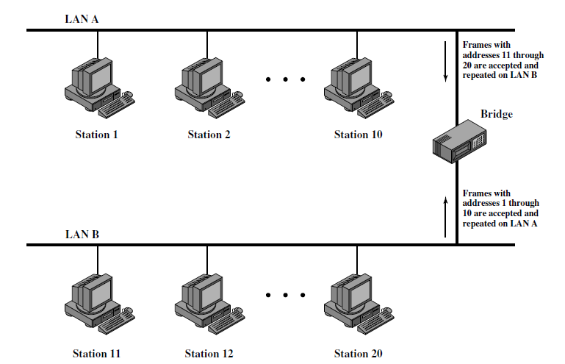
Bridge A bridge goes one step up on a hub in that it looks at the destination of the packet before sending. If the destination address is not on the other side of the bridge it will not transmit the data. It uses MAC address of 48 bits.
<number>

Slide 76
Switch Instead of broadcasting the frames everywhere, a switch actually checks for the destination MAC address and forward it to the relevant port to reach that computer only. This way, switches reduce traffic and divide the collision domain into segments, this is very efficient for busy LANs and it also protects frames from being sniffed by other computers sharing the same segment.
Most common switching methods are:
1. Cut-through: Directly forward what the switch gets. 2. Store and forward: receive the full frame before retransmitting it.
<number>

Slide 77
Router A router is similar in a switch in that it forwards packets based on address. But, instead of the MAC address that a switch uses, a router can use the IP address. This allows the network to go across different protocols. The most common home use for routers is to share a broadband internet connection. The router has a public IP address and that address is shared with the network. When data comes through the router it is forwarded to the correct computer.
Gateway
Gateways are very intelligent devices or else can be a computer running the appropriate software to connect and translate data between networks with different protocols or architecture, so their work is much more complex than a normal router. For instance, allowing communication between TCP/IP clients and IPX/SPX or AppleTalk.
<number>

Slide 78
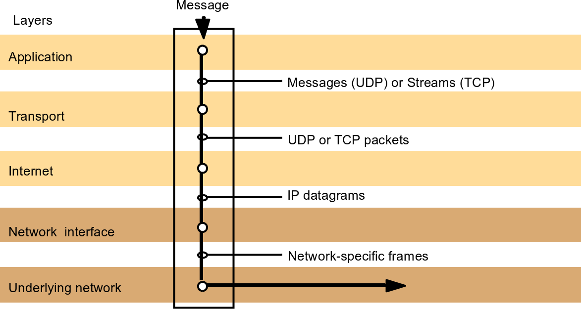
120Networking and internetworking3.4
Internet protocols
3.4 Internet protocols
ARPANET (1970, USA) – the first large-scale computer network Figure 3.12 TCP/IP layers

Slide 79
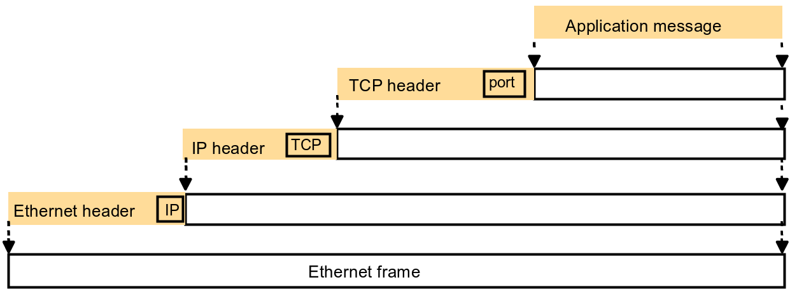
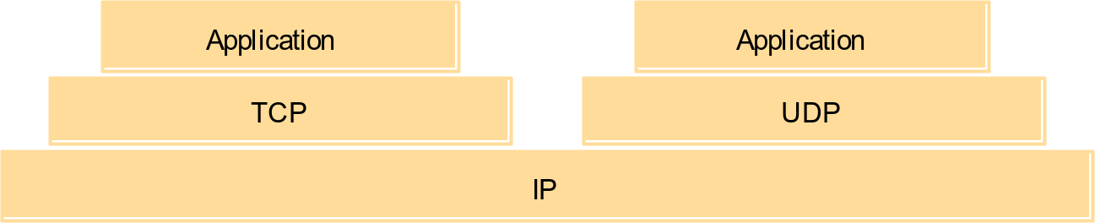
121Networking and internetworking3.4 Internet protocols
Figure 3.13 Encapsulation as it occurs when a message is transmitted via TCP over an Ethernet
Figure 3.14 The programmer’s conceptual view of a TCP/IP Internet

Slide 80
Internet protocols
122Networking and internetworking3.4
IP addressing
Should be
universal
efficient its use of the address space
TCP/IP – 2³² ≈ 4 billion addressable hosts
flexible and efficient routing scheme
addresses themselves cannot contain very much of the information needed to route a packet

Slide 81
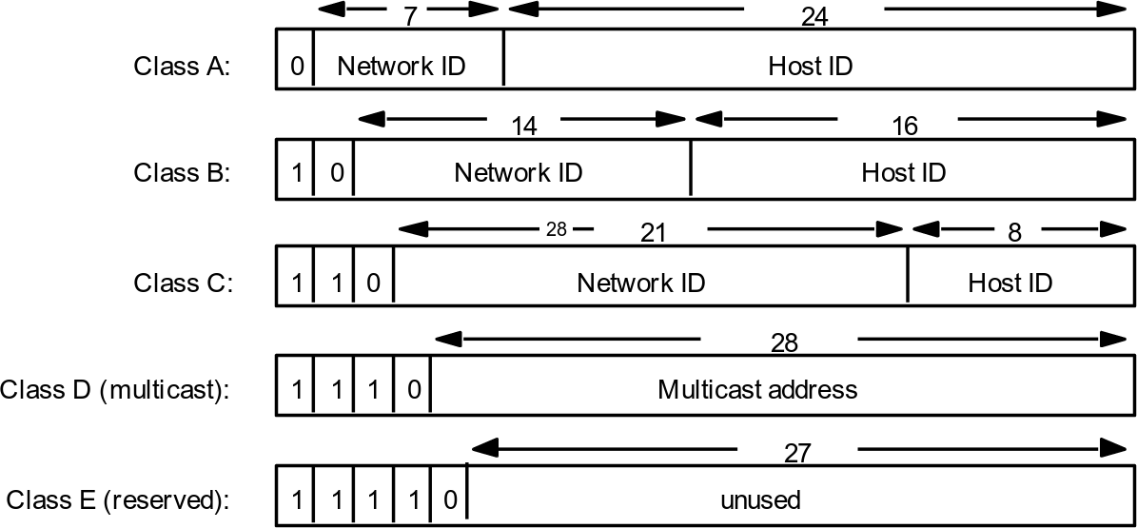
Internet protocols
123Networking and internetworking3.4
Figure 3.15 Internet address structure, showing field sizes in bits

Slide 82
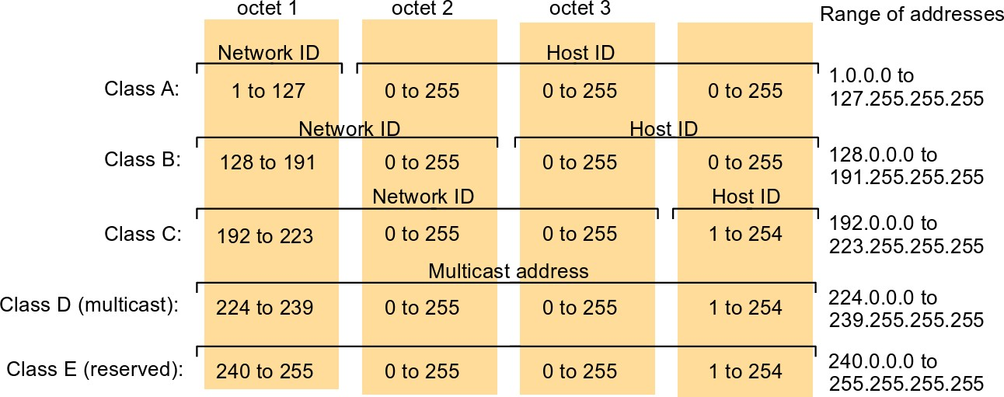
Internet protocols
124Networking and internetworking3.4
Figure 3.16 Decimal representation of Internet addresses
host identifier
0 – this host
all 1s – broacast message
Around 1990: – IP addresses likely to run out around 1996

Slide 83
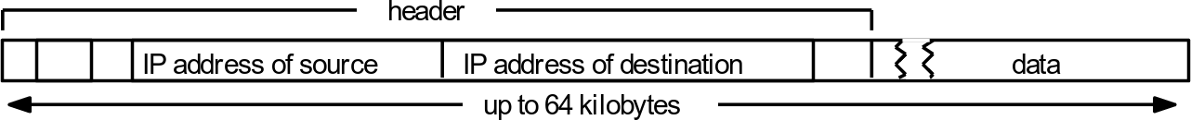
Internet protocols
125Networking and internetworking3.4
Specification of IPv6
Classless InterDomain Routing (CIDR)
Network Address Transition (NAT) scheme to enable unregistered computers to access the Internet
3.4.2 The IP protocol
Figure 3.17 IP packet layout
unreliable or best-effort delivery semantics (doe to no guarantee of delivery)
the only checksum in IP – a header checksum

Slide 84
Internet protocols
127Networking and internetworking3.4
IP routing
Backbones
Topological map of the Internet partitioned into autonomous systems (ASs), which
are subdivided into areas
Every AS in the topological map has a backbone area
The collection of routers that connect non-backbone areas to the backbone and the links that interconnect those routers are called the backbone of the network
Routing protocols
RIP-1 and RIP-2
open shortest path first (OSPF)

Slide 85
Internet protocols
128Networking and internetworking3.4
Default routes
key routers
default destination
Routing on local subnet
using underlying network to transmit the packets
Classless interdomain routing (CIDR)
add mask field to the routing tables
Unregistered addresses and Network Address Translation (NAT)

Slide 86
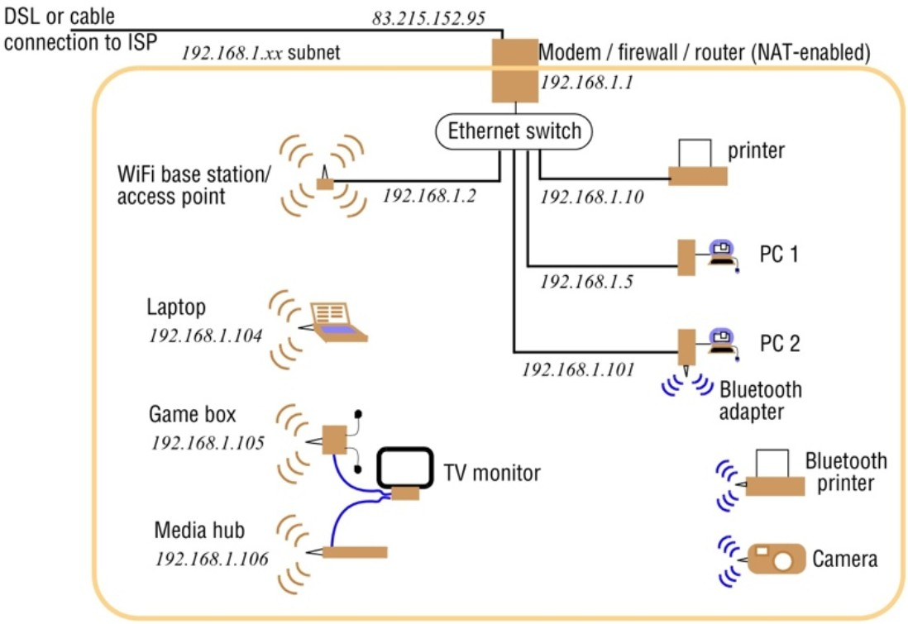
Internet protocols
129Networking and internetworking3.4
Figure 3.18 A typical NAT-based home network
Dynamic Host Configuration Protocol (DHCP)
three blocks of addresses (10.z.y.x, 172.16.y.x or 192.168.y.x) that IANA has reserved for private internets

Slide 87
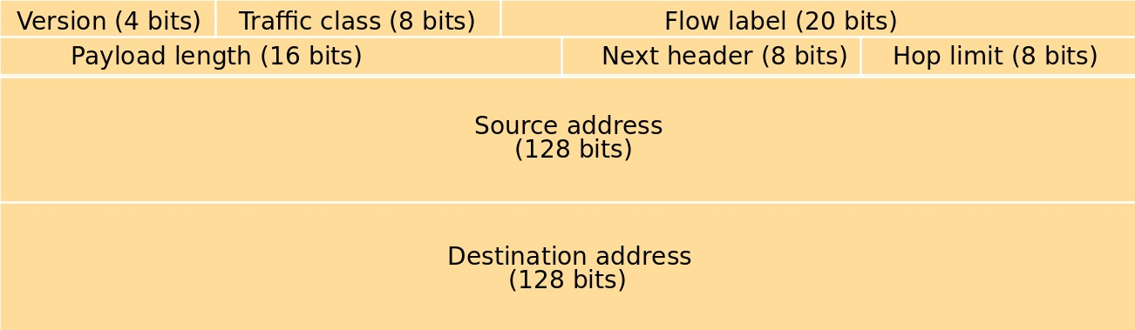
Internet protocols
130Networking and internetworking3.4
3.4.4 IP version 6
Figure 3.19 IPv6 header layout
Address space: 128 bits
– 2¹²⁸ ≈ 3 × 10³⁸ – 7 × 10²³ IP addresses per square meter across the en- tire surface of the Earth (actually ca 1000addresses if to take into account inefficiency in allocation...)

Slide 88
Internet protocols
131Networking and internetworking3.4
Routing speed
no checksum to packet content (called also payload)
no fragmentation
Real-time and other services
flow label – specific packets to be handled more rapidly
Future evolution
next-header field (if non-zero, defines an extension header included in the packet)
Multicast and anycast
anycast – packet delivered to at least one host with a relevant address

Slide 89
Internet protocols
132Networking and internetworking3.4
Security
– implemented through authentication and encrypted security payload ex- tension header
Migration from IPv4
’islands’ of IPv6 connected via tunnels; gradually merging into larger islands
IPv4 address space embedded in IPv6 space

Slide 90
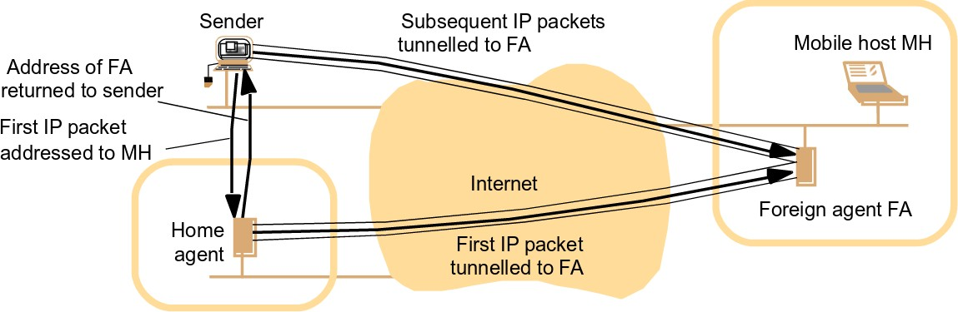
Internet protocols
133Networking and internetworking3.4
3.4.5 MobileIP
home agents and foreign agents etc...
Figure 3.20 The MobileIP routing mechanism

Slide 91
Internet protocols
134Networking and internetworking3.4
TCP and UDP
Functionality:
Use of ports
IP communication between pairs of computers
Transport protocols – TCP and UDP Port number – 16-bit integer
UDP features
almost a transport-level replica of IP
UDP adds no additional reliability mechanisms except the checksum, which is optional
restricted to applications and services not requiring reliable delivery of single or multiple messages

Slide 92
Internet protocols
135Networking and internetworking3.4
TCP features
reliable delivery of arbitrary long sequences of bytes via stream-based program- ming abstraction
additional mechanisms to meet reliability guarantees:
Sequencing
stream divided into sequence of data segments which are transmitted as IP packets
Flow control
reverse flow of data with acknowledgements, which includes window size
– quantity of data that the sender is permitted to send before the next ac- knowledgement

Slide 93
Internet protocols
136Networking and internetworking3.4
Retransmission
if no acknowledgement in specified timeout for a certain packet – it is retransmitted
Buffering
if receive buffer becomes full, incoming packets start getting dropped and no acknowledgement sent back either – causing retransmission
Checksum
Each segment carries a checksum covering the header and the data in the segment. If a received segment does not match its checksum, the segment is dropped

Slide 94
TCP | UDP
It is a connection-oriented protocol. | It is a connectionless protocol.
TCP reads data as streams of bytes, and the message is transmitted to segment boundaries. | UDP messages contain packets that were sent one by one. It also checks for integrity at the arrival time.
TCP messages make their way across the internet from one computer to another. | It is not connection-based, so one program can send lots of packets to another.
TCP rearranges data packets in the specific order. | UDP protocol has no fixed order because all packets are independent of each other.
The speed for TCP is slower. | UDP is faster as error recovery is not attempted.
Header size is 20 bytes | Header size is 8 bytes.

Slide 95
TCP is heavy-weight. TCP needs three packets to set up a socket connection before any user data can be sent. | UDP is lightweight. There are no tracking connections, ordering of messages, etc.
TCP does error checking and also makes error recovery. | UDP performs error checking, but it discards erroneous packets.
Acknowledgment segments | No Acknowledgment segments
Using handshake protocol like SYN, SYN-ACK, ACK | No handshake (so connectionless protocol)
TCP is reliable as it guarantees delivery of data to the destination router. | The delivery of data to the destination can't be guaranteed in UDP.
TCP offers extensive error checking mechanisms because it provides flow control and acknowledgment of data. | UDP has just a single error checking mechanism which is used for checksums.

Slide 96
When to use UDP and TCP?
TCP is an ideal choice, and even it has associated overhead, Therefore, when most of the overhead is in the connection, your application stays connected for any length of time.
UDP is ideal to use with multimedia like VoIP.
Use TCP sockets when both client and server independently send packets at that time; an occasional delay is acceptable. (e.g., Online Poker).
You should use user UDP if both client and server may separately send packets, and occasional delay is also not acceptable. (e.g., Multiplayer games).

Slide 97
Advantage of TCP
Here, are pros/benefits of TCP:
It helps you to establish/set up a connection between different types of computers.
It operates independently of the operating system.
It supports many routing-protocols.
It enables the internetworking between the organizations.
TCP/IP model has a highly scalable client-server architecture.
It can be operated independently.
Supports several routing protocols.
It can be used to establish a connection between two computers.

Slide 98
Disadvantages of TCP
Here, are disadvantage of using TCP:
TCP never conclude a transmission without all data in motion being explicitly asked.
You can't use for broadcast or multicast transmission.
TCP has no block boundaries, so you need to create your own.
TCP offers many features that you don't want. It may waste bandwidth, time, or effort.
In this, model the transport layer does not guarantee delivery of packets.
Replacing protocol in TCP/IP is not easy.
It doesn't offer clear separation from its services, interfaces, and protocols.

Slide 99
Advantage of UDP
Here are the pros/benefits of UDP:
It never restricts you to a connection-based communication model; that's why startup latency in distributed applications is low.
The recipient of UDP packets gets them unmanaged, which also includes block boundaries.
Broadcast and multicast transmission are also available with UDP
Data loss can be made
Small transaction ( DNS lookup)
Bandwidth intensive app which endures packet loss

Slide 100
Disadvantages of UDP
Here, are important cons/drawback of UDP:
In UDP protocol, a packet may not be delivered or delivered twice. It may be delivered out of order, so you get no indication.
Routers are quite careless with UDP, so they never retransmit it if it collides.
UDP has no Congestion Control, and flow control, so implementation is the job of a user application.
UDP mostly like to suffer from worse packet loss

Slide 101
137Networking and internetworking3.4 Internet protocols
Domain names
scheme for the use of symbolic names for hosts and networks (for example,
binkley.cs.mcgill.ca or essex.ac.uk.)
organized into a naming hierarchy (which is independent of the physical layout of the networks)
DNS is implemented as a server process
can be run on host computers anywhere in the Internet
at least two DNS servers in each domain (often more)
servers in each domain hold a partial map of the domain name tree below their domain
DNS would not be workable without the extensive use of caching, since the ‘root’ name servers would be consulted in almost every case, creating a service access bot- tleneck.

Slide 102
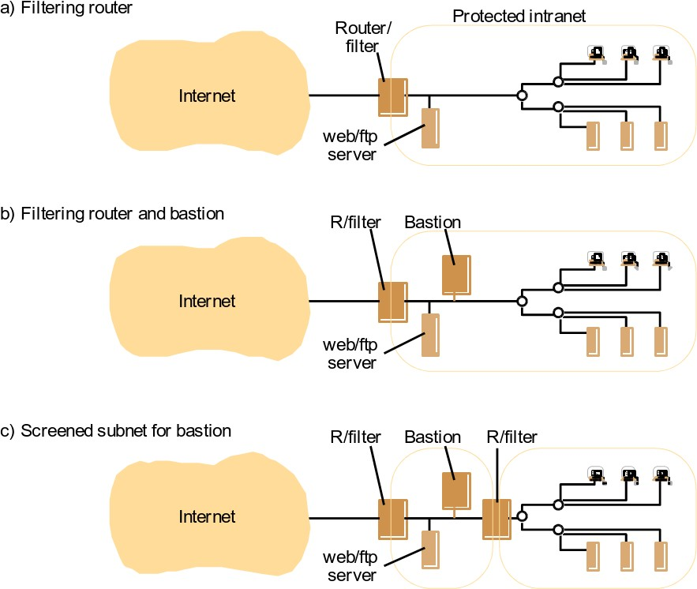
Internet protocols
138Networking and internetworking3.4
3.4.8 Firewalls
Firewall is implemented by a set of processes that act as a gateway to an intranet Figure 3.21 Firewall configurations

Slide 103
139Networking and internetworking3.4 Internet protocols
Service control: To determine which services on internal hosts are accessible for external access and to reject all other incoming service requests.
Behaviour control: To prevent behaviour that infringes the organization’s policies, is antisocial or has no discernible legitimate purpose
User control: Organizations may wish to give a set of users other privileges than others...
IP packet filtering: for example, based on port numbers – no NFS usage from outside
TCP gateway: TCP segments can be checked for correctness (some denial of ser- vice attacks use malformed TCP segments to disrupt client operating systems)
Application-level gateway: An application-level gateway process acts as a proxy for an application process
Virtual private networks (VPNs)
– extend the firewall protection boundary beyond the local intranet by the use of
cryptographically protected secure channels at the IP level

Slide 104
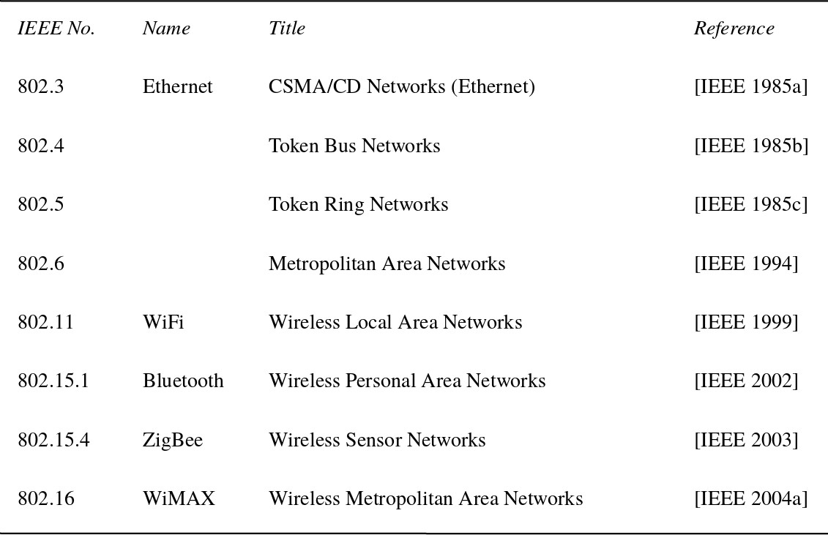
140Networking and internetworking3.5
Case studies
3.5 Case studies
Figure 3.22 IEEE 802 network standards

Slide 105
141Networking and internetworking3.5
3.5.1 Ethernet
Home task: read the book (pp 144-154), in particular:
Packet broadcasting Ethernet paket layout Packet collisions Ethernet efficiency Physical implementations
Case studies

Slide 106
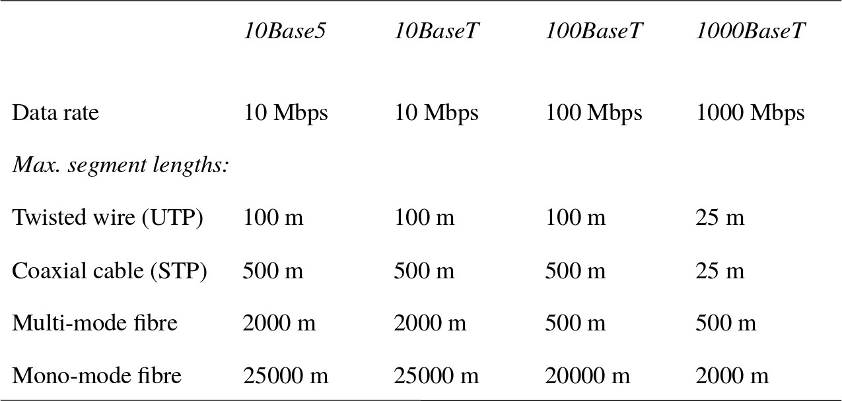
142Networking and internetworking3.5
Figure 3.23 Ethernet ranges and speeds
Case studies
Ethernet for real-time and quality of service critical applications

Slide 107
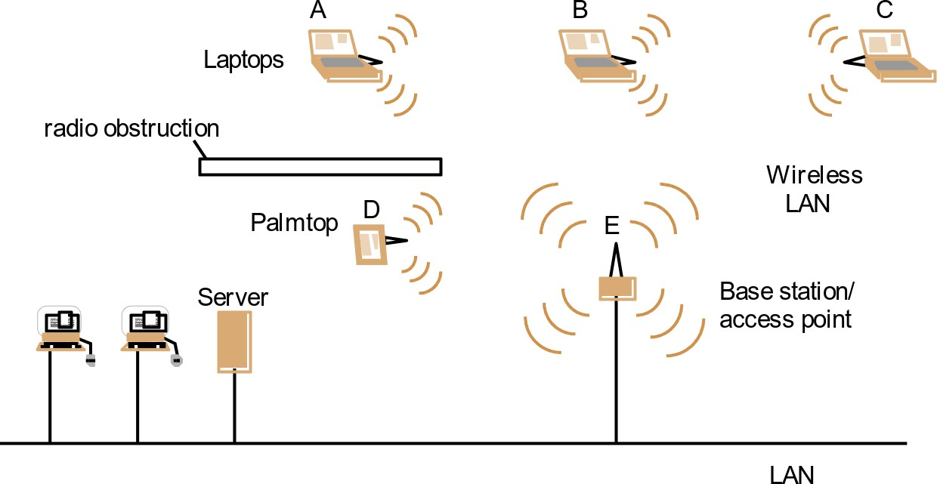
143Networking and internetworking3.5
3.5.2IEEE 802.11 (WiFi) wireless LAN
Figure 3.24 Wireless LAN configuration
Case studies
Security
End of week 3

